Slide 1
‘Gearing up’
Some tools and ideas we’ll be using all quarter!

Slide 2
REMINDER: Please complete the survey on canvas!

Slide 3
Today’s Outline
Follow up questions?
The tools we’ll use (mostly)
  Github
    Git is optional
  Visual Studio Code (with Live Server)
  QGIS
“Our First Web Site”
  Hello HTML!

Slide 4
Questions on the class structure?
A few key points:
There are four Undergraduate quizzes and four Graduate student meetings. The dates are on the syllabus (the first meeting is this Friday; the first Quiz is Wednesday, 1/21).
There are five labs and a final project
  Labs are Monday in Strand 361 (2:00pm - 3:50pm)
Lectures are M/W/F here in Strand 361
  Lectures will be ~⅓ lecture, ~⅓ activity, and ~⅓ discussion
There are two bonus assignments towards the end of the quarter
  There may be other opportunities, these are guaranteed

Slide 5

The tools we’ll mostly use - Github
A website and project hosting service built on the Git version control system
Provides an online suite of tools that include cloud storage, hosting of projects, rendering of geojson data, etc. (there’s a lot out there)
One of the most common sites to store, share, and collaborate on open-source projects
Basic element is the repository

Slide 6
The tools we’ll mostly use - Github
Repository -
Can be thought of as a your project’s folder or directory (but can contain many sub-folders and so on)
Basic interactions are cloning, committing, pushing, pulling, and forking.

Slide 7
The tools we’ll mostly use - Github
Cloning -
A copy of a repository that is on your computer instead of a website’s server. You can edit these files and then commit them using Git to track changes.

Slide 8
The tools we’ll mostly use - Github
Committing -
When you commit a set of files using Git, you are saving a snapshot of that file with a unique ID. All of these snapshots are tracked, so if you make a big mistake you can always revert to an earlier version.
As they say, commit early and commit often.

Slide 9
The tools we’ll mostly use - Github
Pushing-
Refers to sending committed changes to a remote repository.
In this class, that will (almost always) be github.

Slide 10
Wait… what?
Github and git can be very confusing.
Git is a tool developed by Linus Torvalds (think linux) that handles distributed version control.
Github is a wonderful website, now owned by Microsoft, that allows for easy storing and sharing of git repositories on the web (and a lot more)
If that’s not clear right now, that’s ok. We’ll have ample opportunities to work through this (including your first lab).

Slide 11
An imagined workflow
I make a cool program (cool_program.js)
I commit it locally and push it to GitHub
You see something wrong with it! You fork the code and clone it to your computer to work on it.
You fix it, commit and push it to your branch of the repository (here, a forked repo).
You submit a pull request that notifies me of your fix.
I review it, we talk, and eventually I merge your branch back into the main one.
Boom! Collaboration!

Slide 12
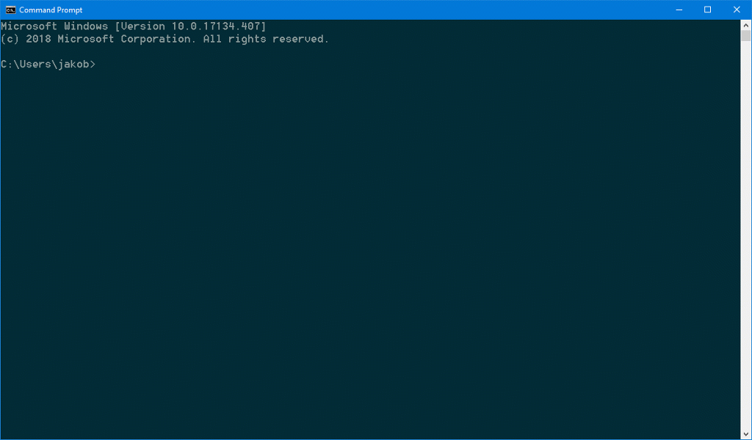
Git is optional…
As you will shortly see, there are multiple ways to interact with GitHub.
One common way is through Git which you interact with using the command line.
Another is using the desktop github applications.
A third would be simply using the web (this is awkward and not advised!)
I strongly recommend using command line Git, will be using it myself, and will use it in demonstrations.
But, you are free to use whatever is most comfortable for you.
You’ll learn more about these differences as we move along.

Slide 13
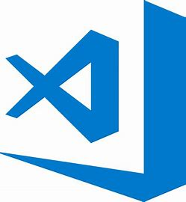
The tools we’ll mostly use - Visual Studio Code
Visual Studio Code is another open source development tool… owned by Microsoft.
If you’re familiar with the atom project, this is the replacement (more or less).
If you’re not, it’s a lightweight code editor that runs on your desktop.
It has streamlined debugging, git integration, and a host of other features that make it an excellent tool for web development

Slide 14
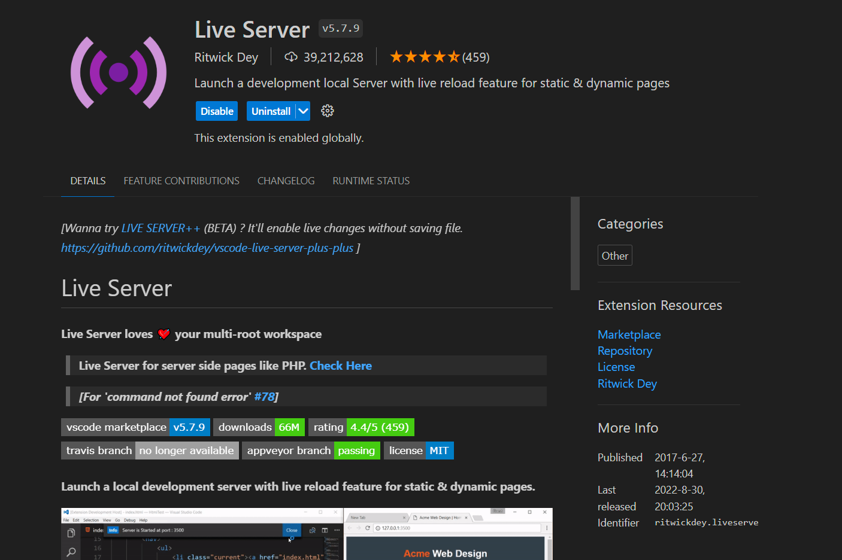
The tools we’ll mostly use - Visual Studio Code
Of particular importance for us:
  The Live Server Extension
This extension sets up a local web hosting server so that you can very quickly test out your code without having to upload it somewhere, etc.
While you can often run ‘static’ web pages locally without a server, the types of dynamic visualizations we’ll be doing require one.

Slide 15

Last, but not least - QGIS
… it’s basically open-source ArcGIS
But, that means it has a lot of extensions and plug-ins that Arc might not…
In your first lab, you use QGIS to make a web map. This is to give you a nice base familiarity.
You are always welcome to use Arc (or any other tool, language, software, etc.) - unless explicitly told otherwise

Slide 16
Ok, one last, last, last thing…
In this class, you are encouraged to make use of AI tools (like ChatGPT) to help with your coding. You must disclose when you use it (just leave a comment in your code).
We will discuss this more in the coming weeks (including examples of how I use it), but for now, two points:
These early exercises are fundamental, so please do try them without tools at first.
When I say for code, I mean for code. Use AI for what it’s best at, use yourself for what you are. Write like a human because you are one, code like a machine because…

Slide 17
For now, an activity!
Let’s make a ‘first’ web page.
  Please note, this is very basic, if you are familiar with html and what not - awesome, feel encouraged to help others!
Go to github.com and create a free github account.
  Once you’ve done so, email me - thatchja@oregonstate.edu - with either the email address you used or the username you chose.
  You should have taken care of this on Monday, but in case you haven’t, now is your chance!
Now, we’re going to create the simplest web page imaginable and host it at username.github.io (you can delete this once we’re done)

Slide 18
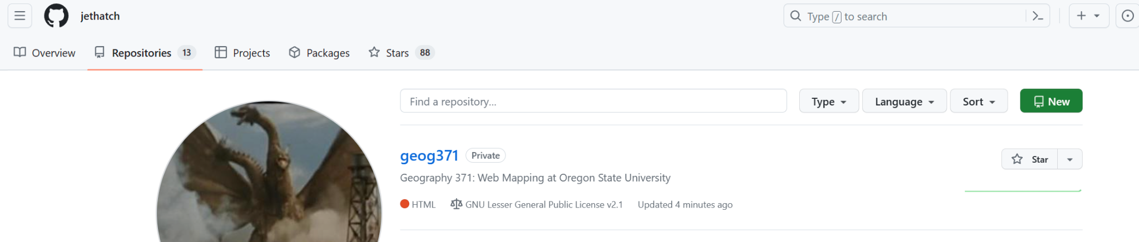
Step 1 - Create a repository
Log into Github, go to the repositories tab, and click the ‘new’ button.
Call it whatever you want, I recommend ‘helloworld’

Slide 19
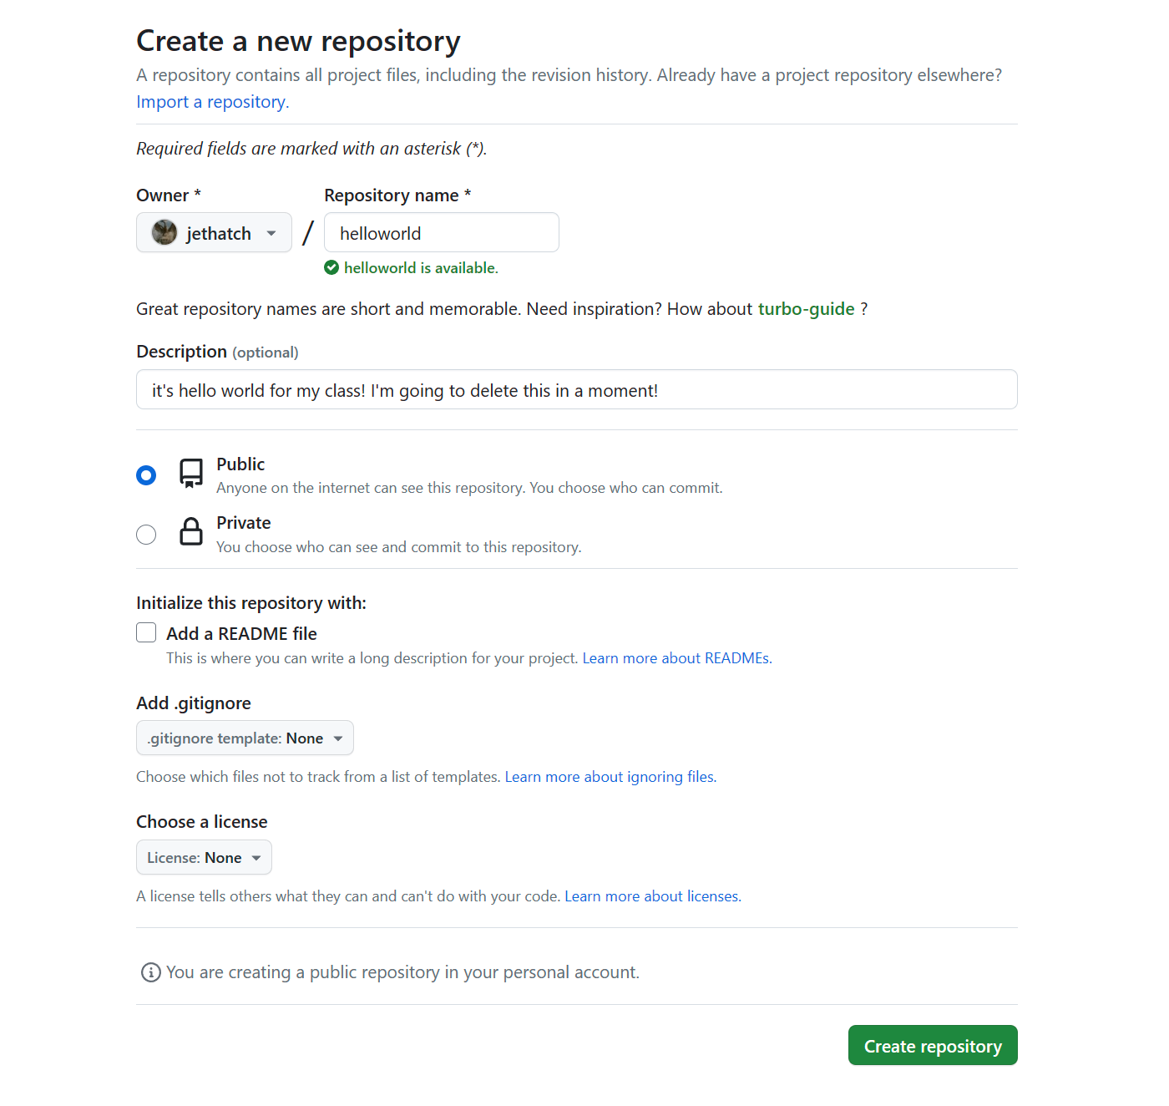

Slide 20
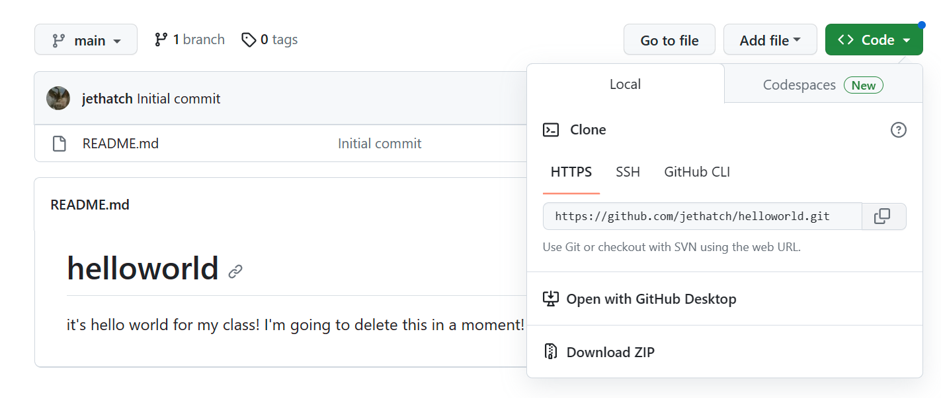
Step 2 - Clone it down…
Please note, for something this simple, you could easily create it entirely using the GitHub web interface… If you feel comfortable with what I’m asking you to do, feel free to do it however you like. However, if you’re confused, please follow along!
Click the <> Code button and copy the address…

Slide 21
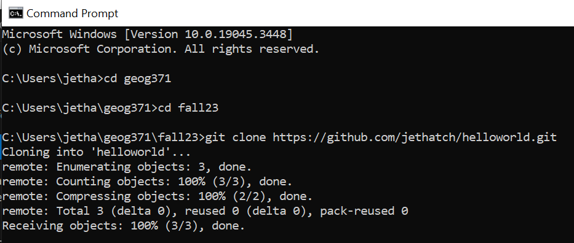
Step 2 - Clone it down…
Go to the “command prompt” on windows (you can search for ‘cmd’ and it will pop up)
Navigate to where you want to store this file (if you’re not sure, ask!)

Slide 22
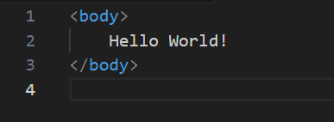
Step 3 - Create the .html
Open up Visual Studio Code and create a new file. Choose the language as .html (this is optional)
Set up your code like so and save it as index.html in the directory where you cloned the repository

Slide 23
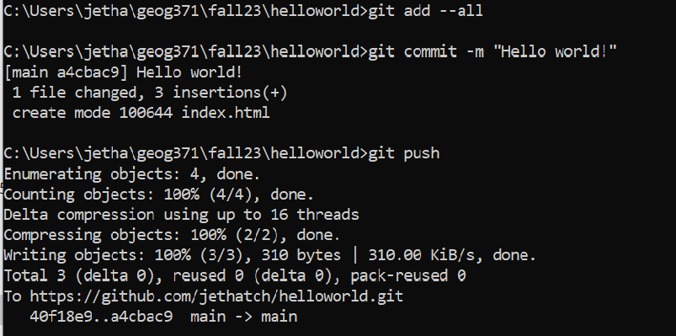
Step 4 - Time to add, commit, and push!
First, we’ll add our files to the repository. Then, we’ll commit them. Finally, we’ll push them up.

Slide 24
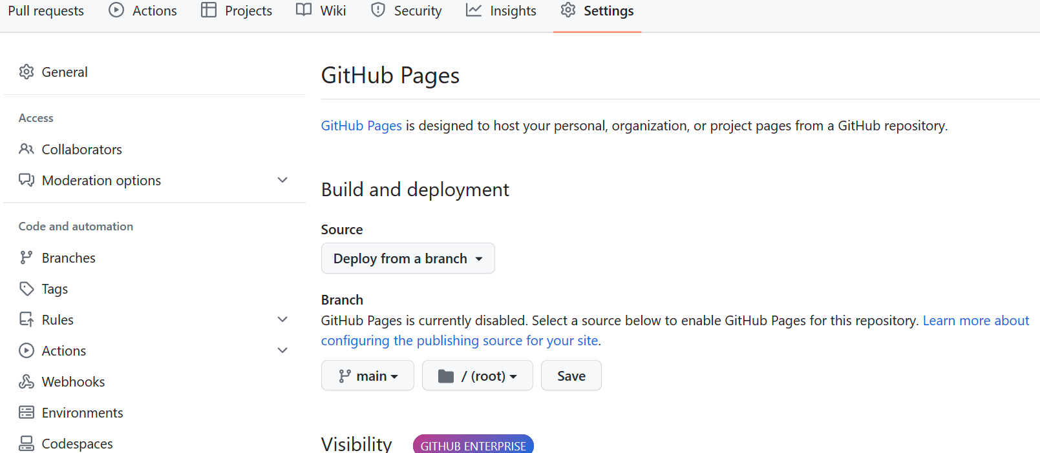
Step 5 - One last step… (which you could also do at the beginning…)
Go back to Github, go to your repository. Click on Settings, then Pages.
Set the branch to main and click save.

Slide 25
Go check it out (it may take a few moments)
Go to [username].github.io/[repository_name]/
Boom.
Yes, this was simple. However you gained experience:
  Creating repositories and using Git to commit and push them.
  Working with html
  Using Visual Studio Code.

